Slide 1
Introduction to gis using qgis Part I
Daniela Spade | Instructor PhD Candidate | OU Department of Geography and Environmental Sustainability GIS Outreach Coordinator | Center for Spatial Analysis
dspade@ou.edu
Molly Simonis, PhD| Teaching Assistant OU Department of Biology

Slide 2
Downloads and data
QGIS Software: https://qgis.org/en/site/forusers/download.html
Data to download
NYC Boroughs
311 DOT service requests
Parking facilities
Community districts

Slide 3
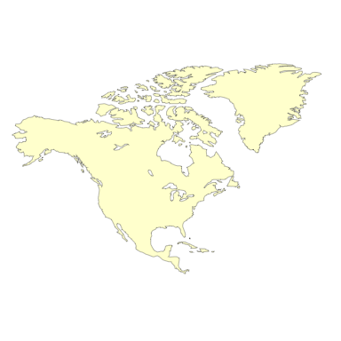
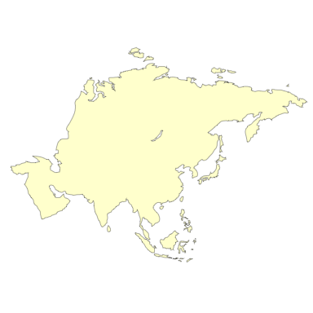

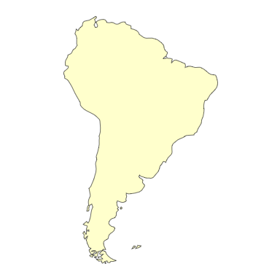

Goals and outcomes of course
Describe the foundational concepts of spatial analysis and mapmaking
Describe the general structure and purpose of Geographic Information Systems (GIS) as well as the sources and formats of spatial data
Apply concepts of spatial analysis using NYC Open Data to answer an NYC-related problem
Discuss resources for further information and instruction on QGIS and other spatial analysis tools
Familiar with foundational concepts in spatial analysis and mapmaking
Understand the structure and purpose of GIS
Practiced in applying spatial concepts to real-world problems
Familiarized with resources for further information on how to use QGIS for spatial analysis and mapmaking

Slide 4
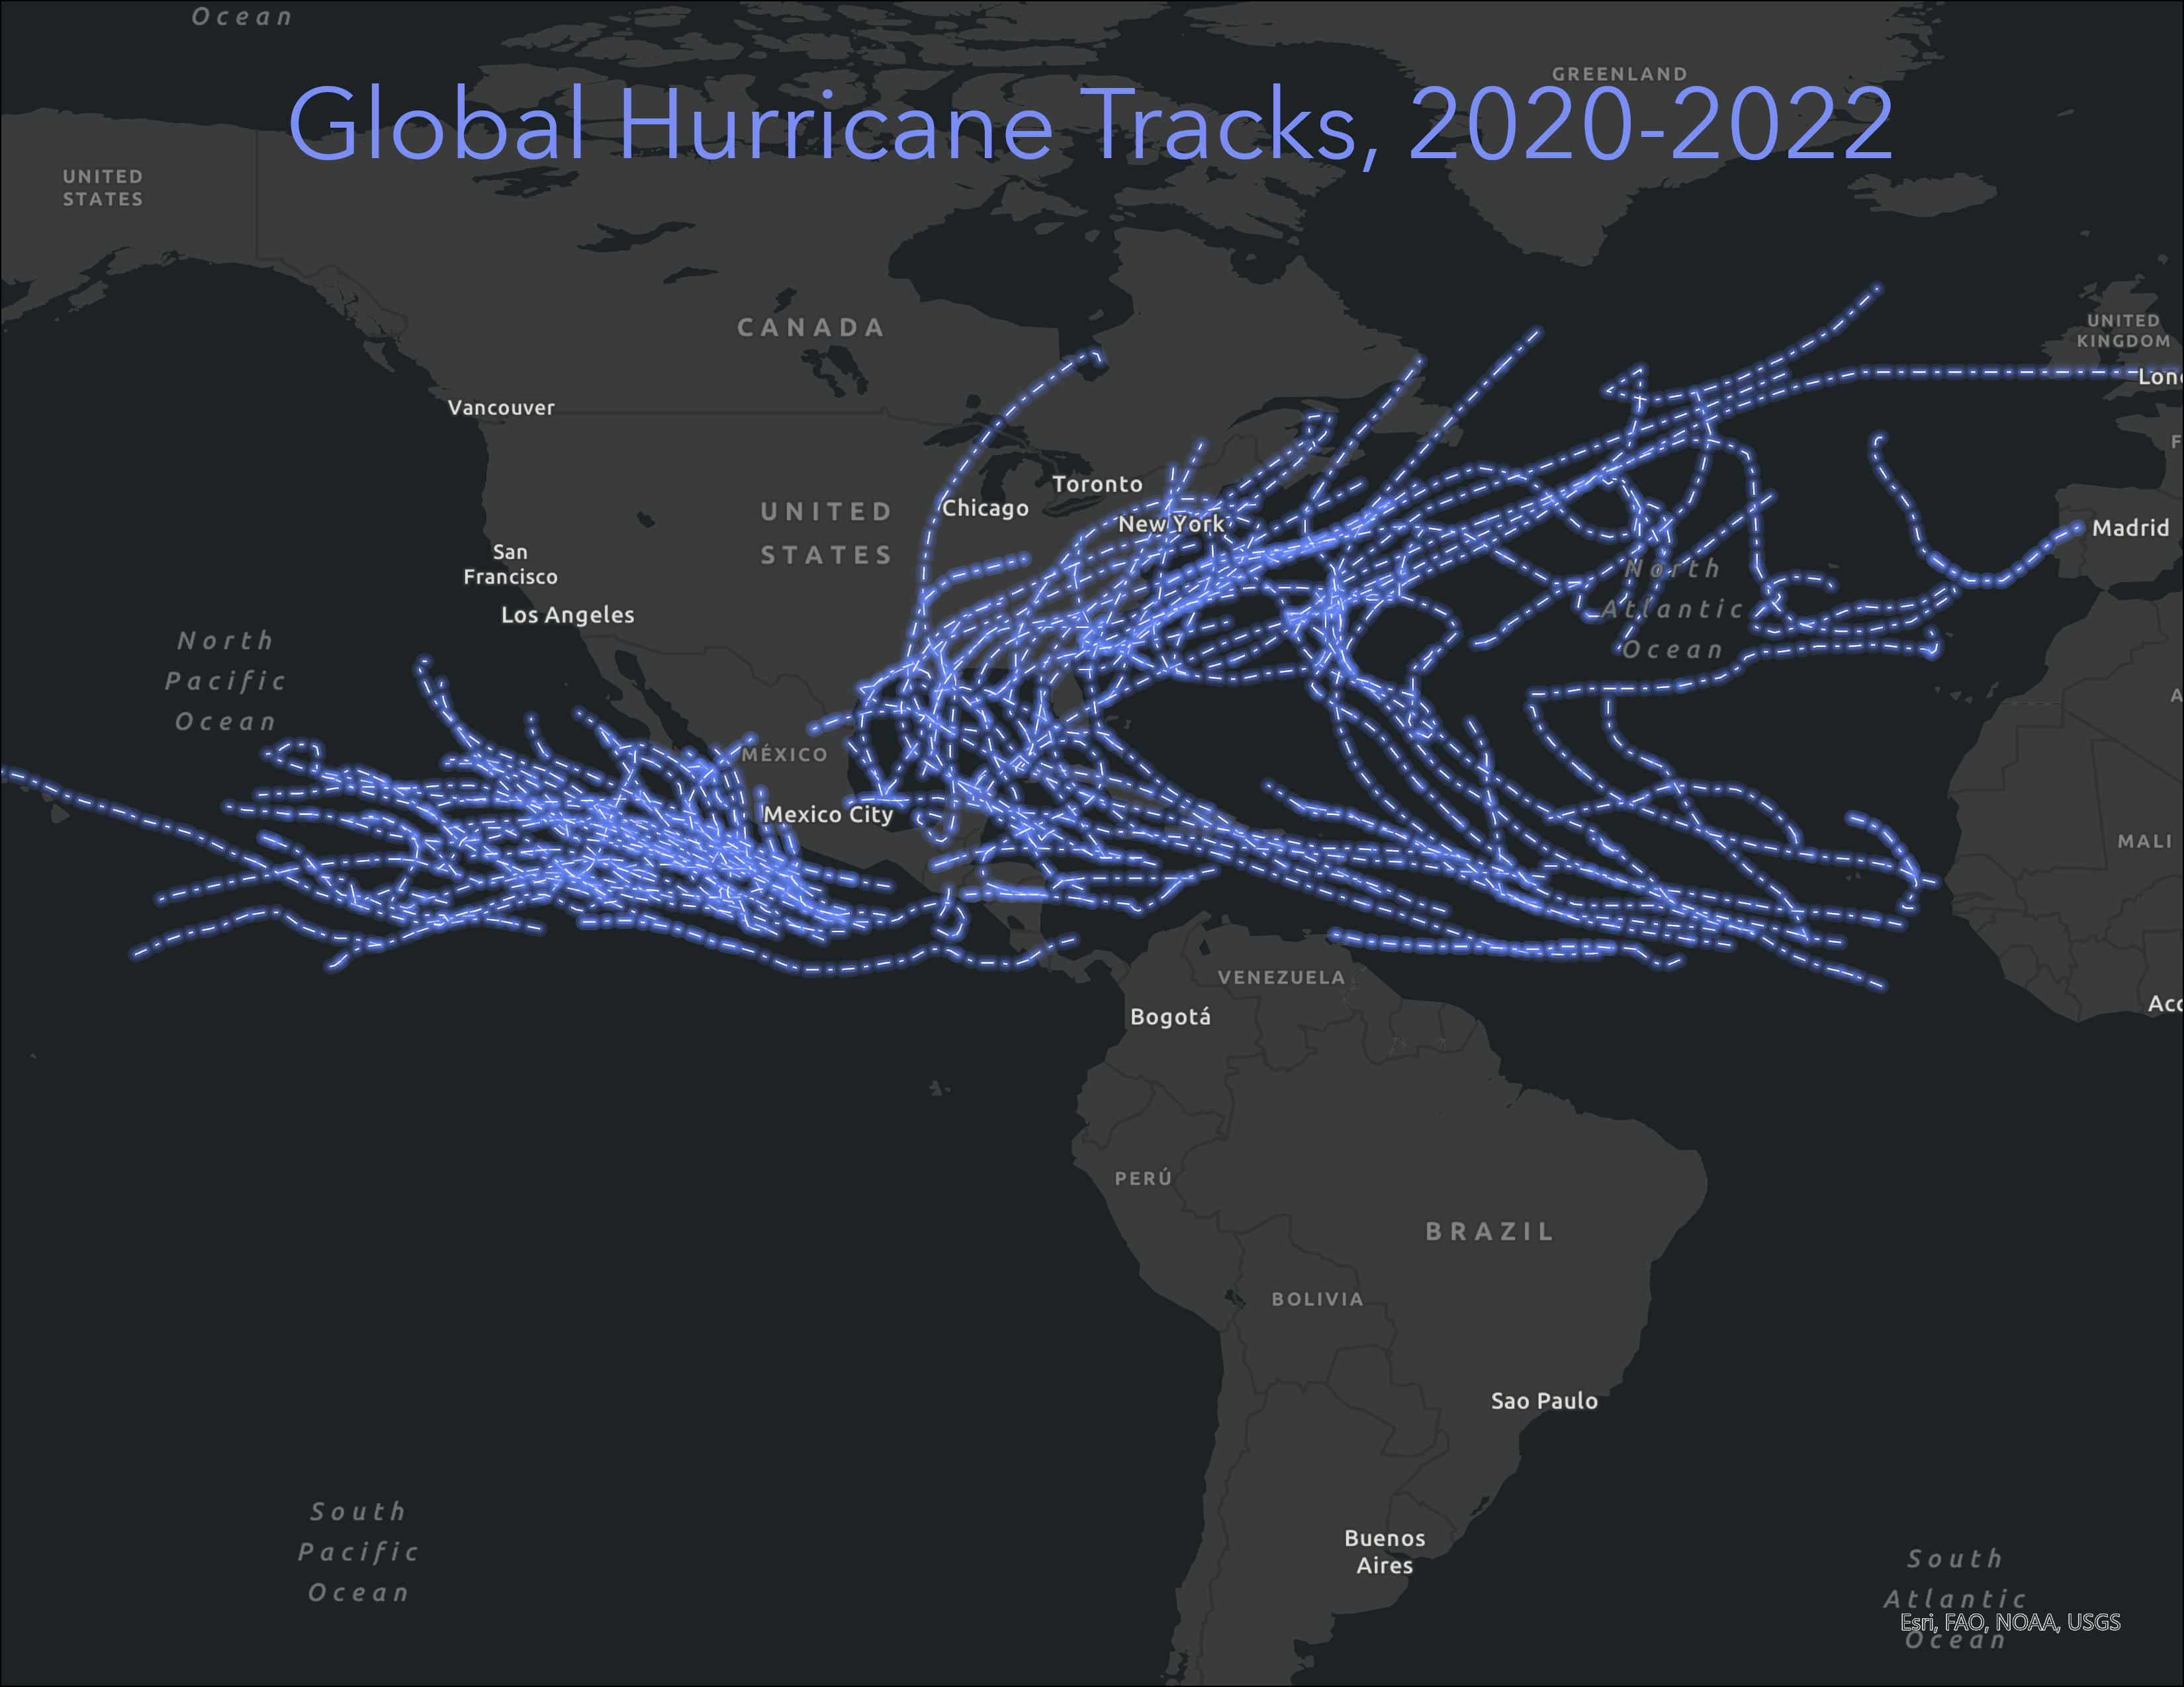
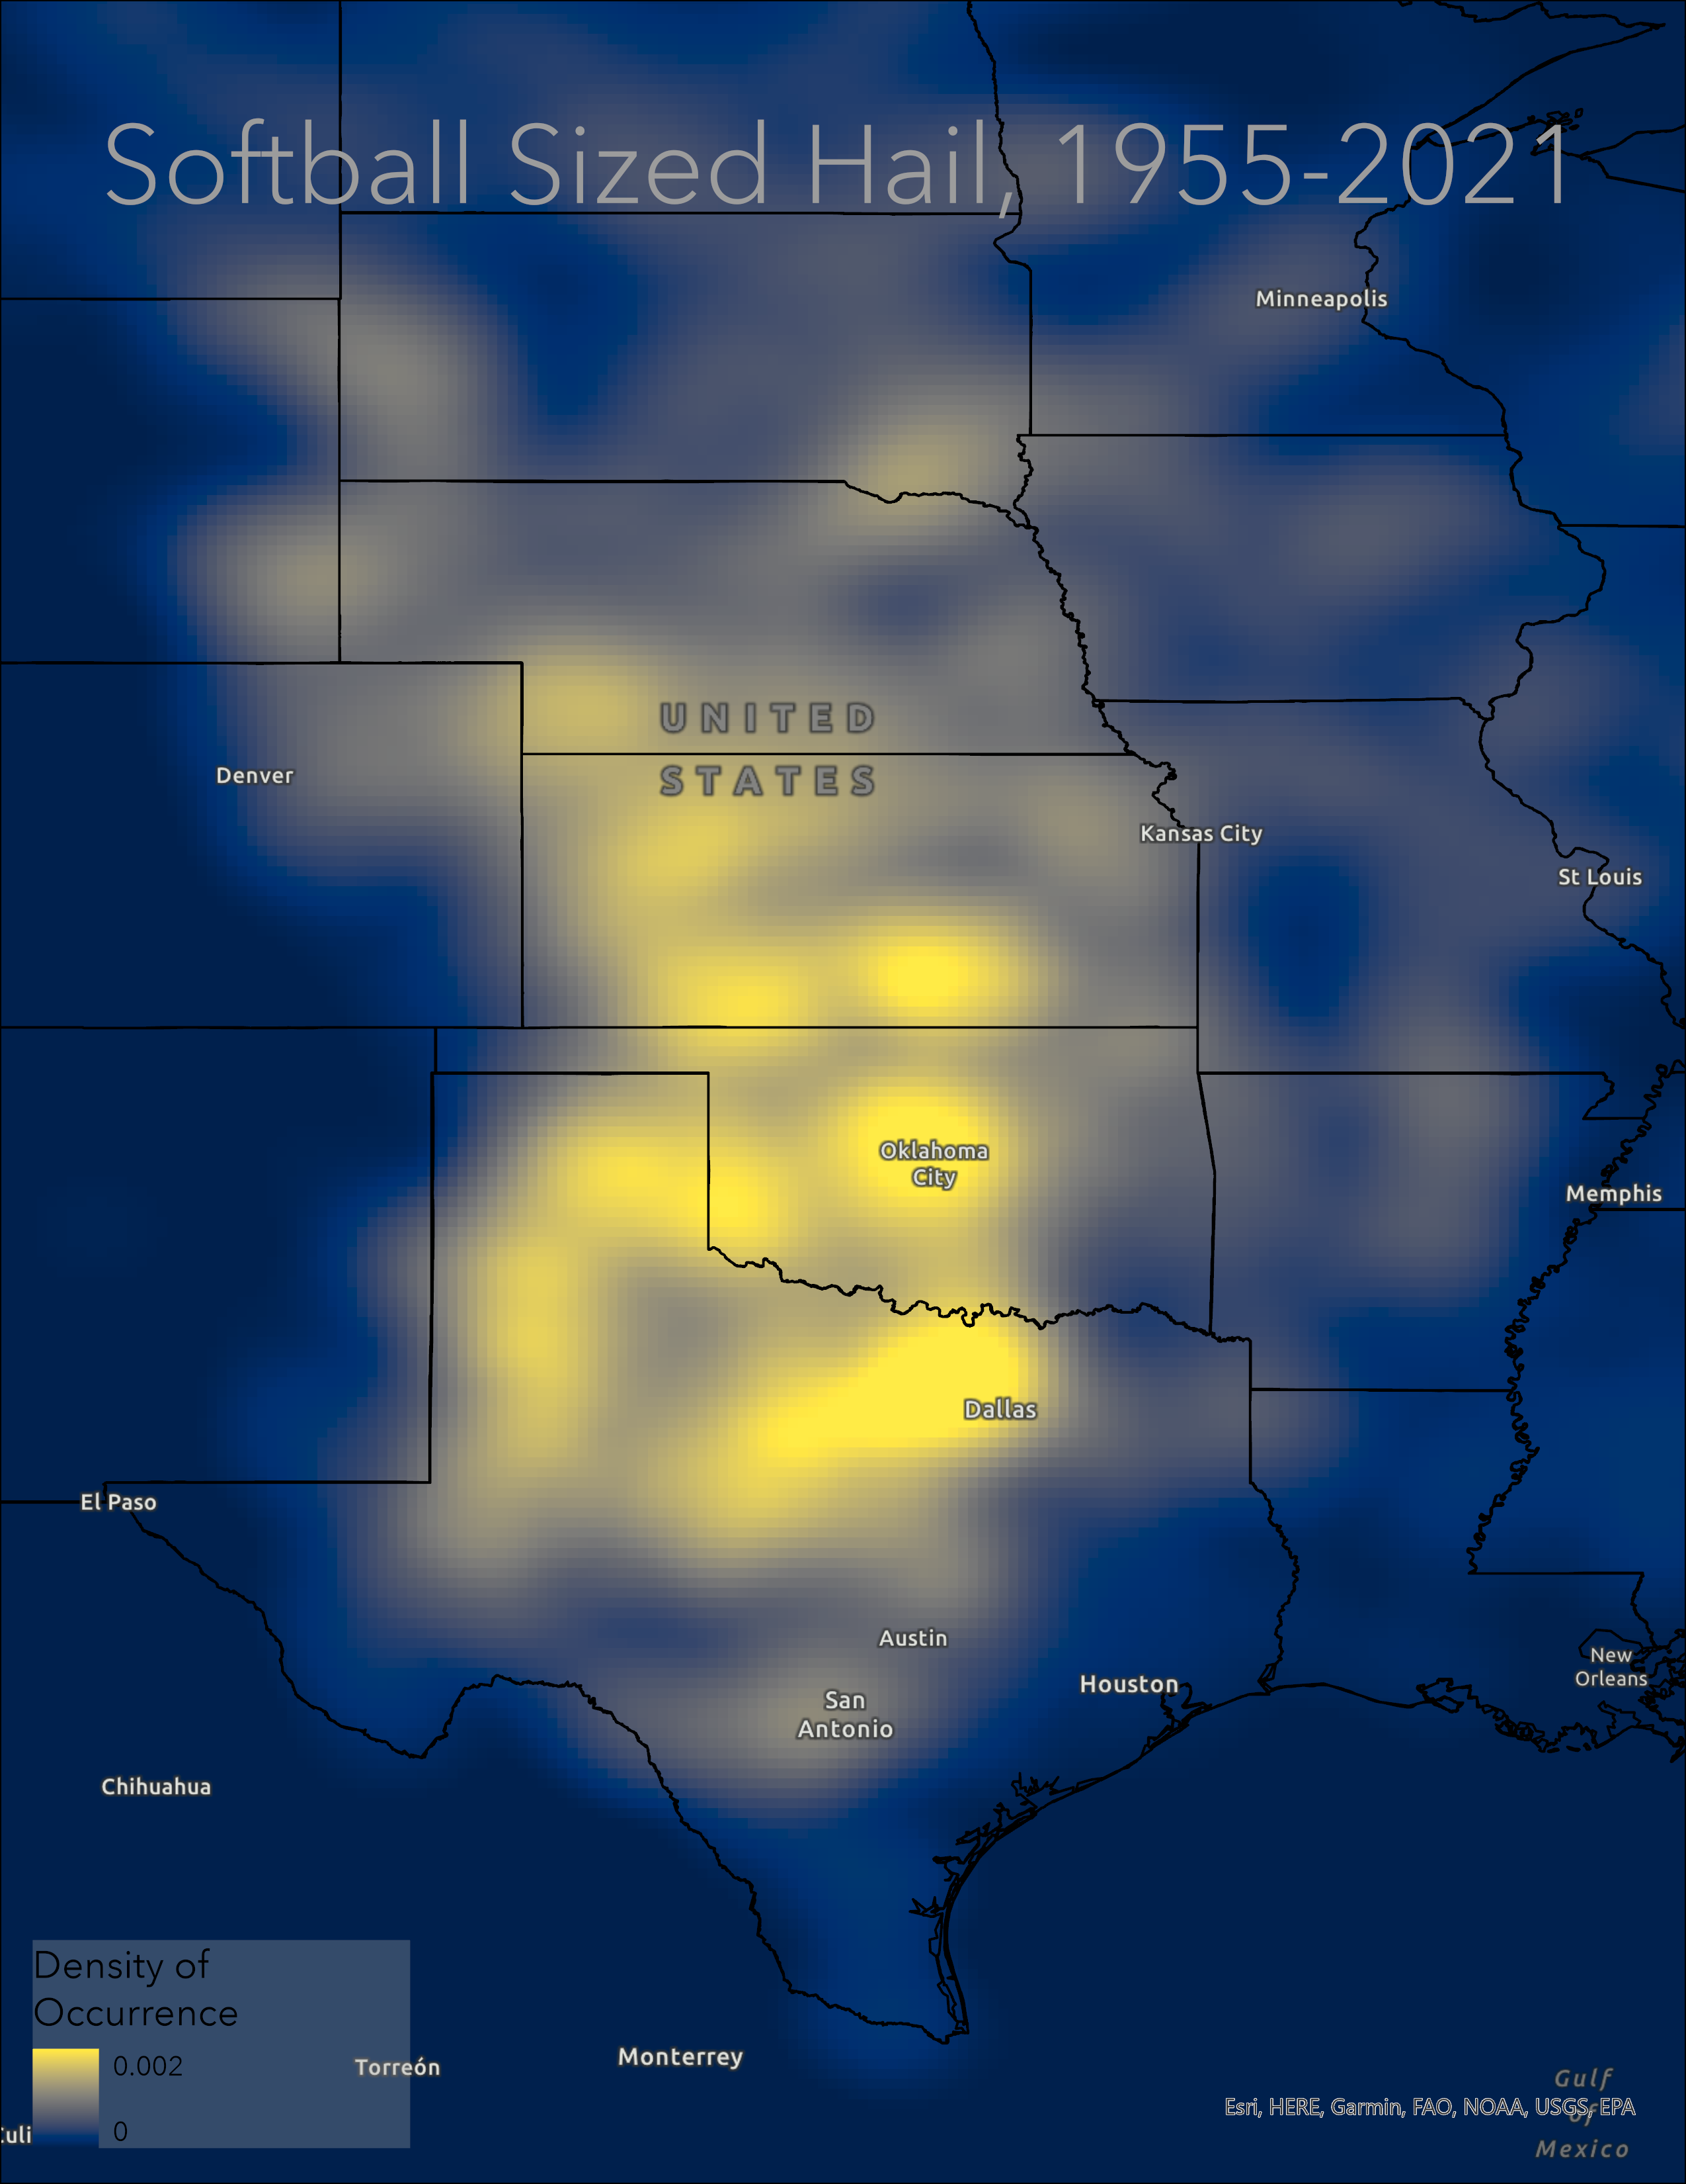
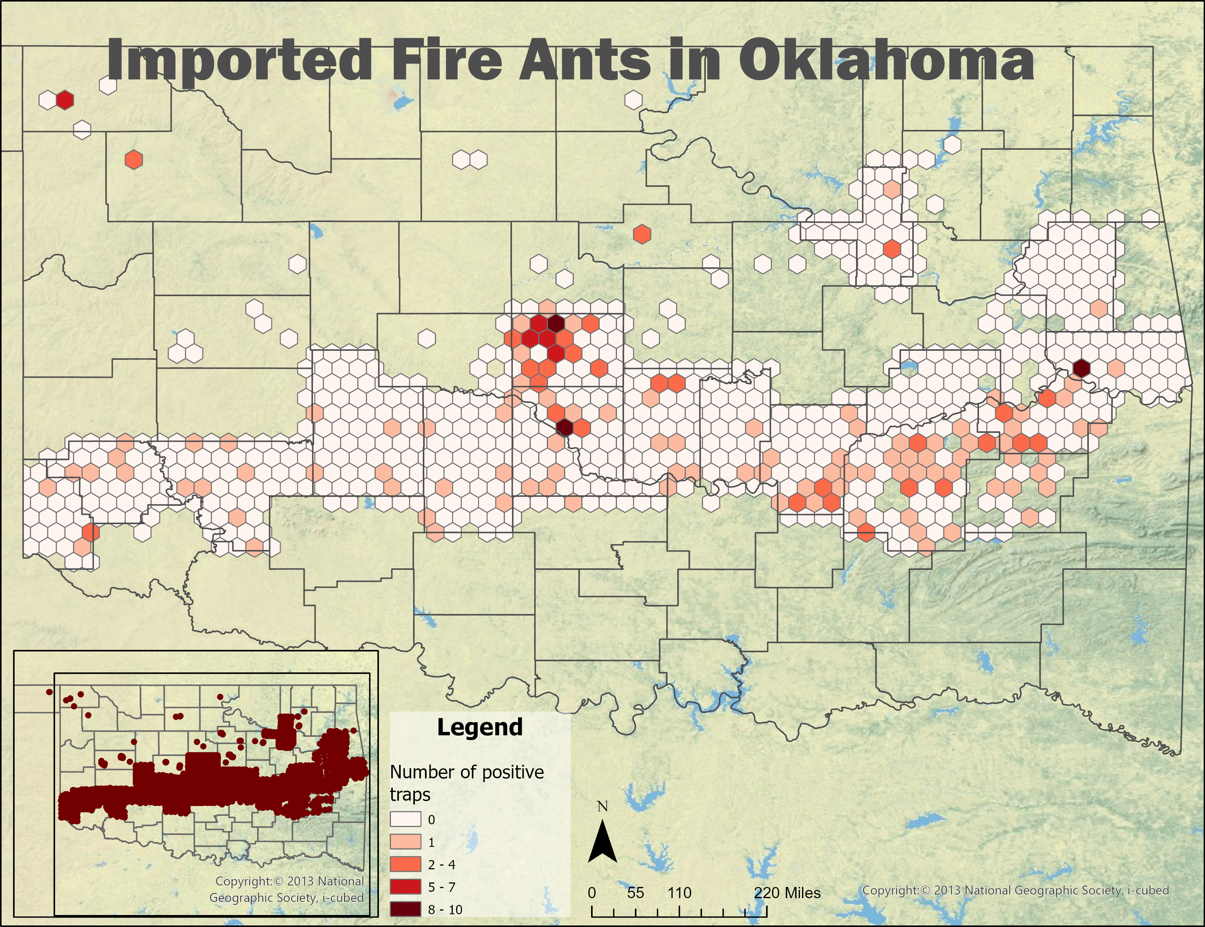
Goals for today
Review basic geospatial principles and GIS tools
Review spatial data formats
Learn how to
Load
Filter
Select
Style
Export
spatial data in QGIS

Slide 5
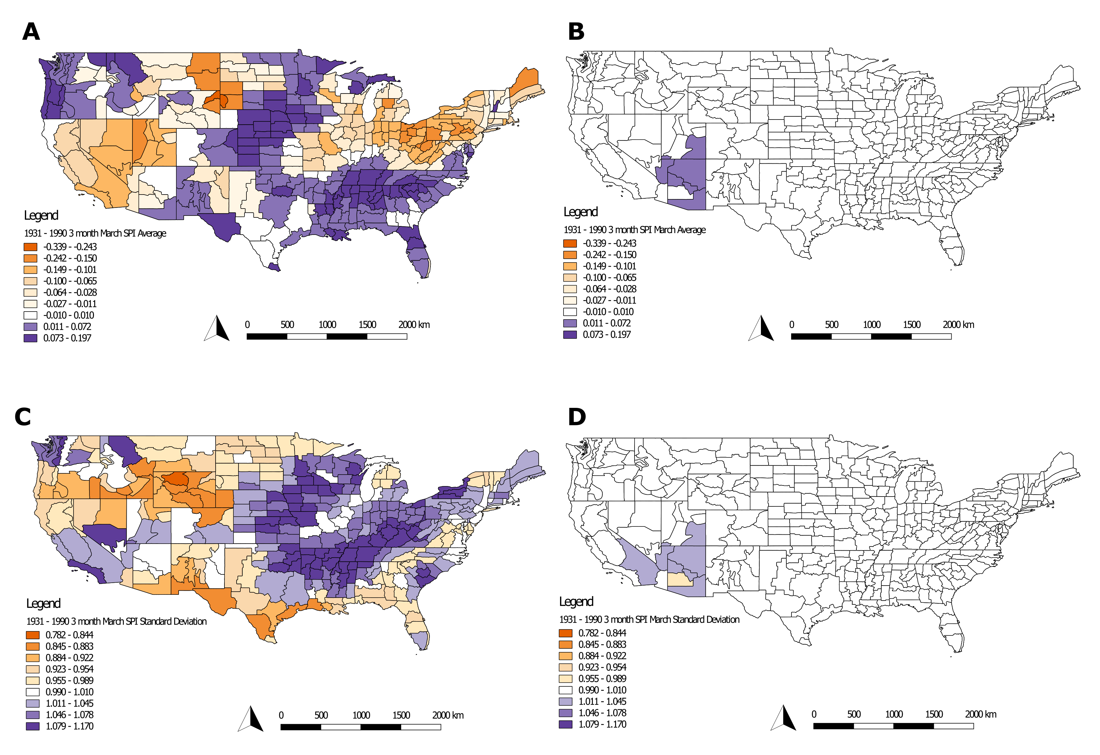
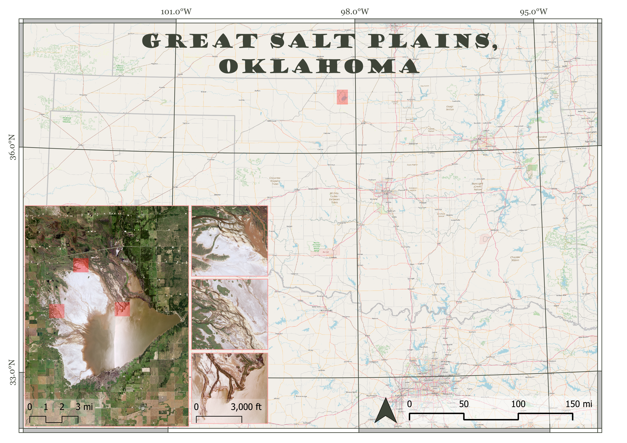
Types of maps
Figure 1
Thematic Maps
Portray geographic patterns of a particular subject matter or theme in a geographic area
Use map symbols to visualize selected properties of geographic features that are not naturally visible
Ex: Temperature
Language
Population
General Reference Maps
In contrast to thematic maps, reference maps focus on the location (rather than properties) of a diverse set of physical features
Rivers
Roads
Buildings
Figure 2
Notes:
Part of the beauty of maps is that they can be used in a variety of different ways, from navigation, to establishing ownership, to presenting information
Fig 1: Thematic map created in QGIS showing the average and standard deviation values of a drought index in the United States for each climate division in the country
Fig 2: Reference amp created in QGIS showing location of the Great Salt Plains in Oklahoma

Slide 6

Geospatial data models
To visualize spatial features on a map, first determine how best to represent the feature. Two primary data models to choose from:
Vector data model
Most common geospatial data format
Storage efficiency
Represents specific features on Earth’s surface as discrete
Points
Lines
Polygons
Capture location by assigning coordinates to these individual geometric objects
Vector data model has two information components
Location of feature
Description of feature’s attributes
Most common vector file format is the shapefile. Consists of multiple files, but only 3 are required for valid shapefile:
.shp: Contains the geometry
.shx: Shape index file; meaningless without the .shp file
.dbf: Database file – contains the geometry attributes
Raster data model
Consists of rows and columns of equally sized and interconnected cells or pixels
Each cell represents a single value
Digital photographs are based on the raster data model
Zoom into digital image to see array of tiny square pixels
Raster pixels may be triangles, hexagons, or even octagons
Square pixels represent the simplest geometric form with which to work and are most common
Each cell in a raster carries a single value, which represents the characteristic of the spatial phenomenon at a location denoted by its row and column
Ex: In a land-use/land-cover raster graphic, the following rule may be applied: 1 = grassland, 2 = agricultural, 3 = disturbed, and so forth
Raster model averages all values within a given pixel to yield a single value.
The more area covered per pixel, the less accurate the associated data values. The area covered by each pixel determines the spatial resolution of the raster model.
Resolution is determined by measuring one side of the square pixel
Notes:
Vector data most common geospatial format because it is the most efficient way to store geospatial information – in general requiring fewer computer resources to store and process than raster data
Raster data stores data in a grid of rows and columns

Slide 7
Shapefile format
Shapefiles
Basic file for storing map elements
Stores spatial data, like points, lines, and polygons
Multiple files comprise a “shapefile"
Limitations
One geometry type (Point, Line, Polygon) per shapefile, sometimes you end up with multiple shapefiles
Column names can only be letters, numbers, and underscores "_"
Column names can only be ten characters long
Shapefile file components:
.shp — The main file that stores the feature geometry
.dbf — The dBASE table storing attribute information of features
.prj — The file that stores the coordinate system information
.shx — The index file that stores the index of the feature geometry
.cpg—Identifies the character set to be used
.sbn and .sbx—The files storing spatial index of the features

Slide 8
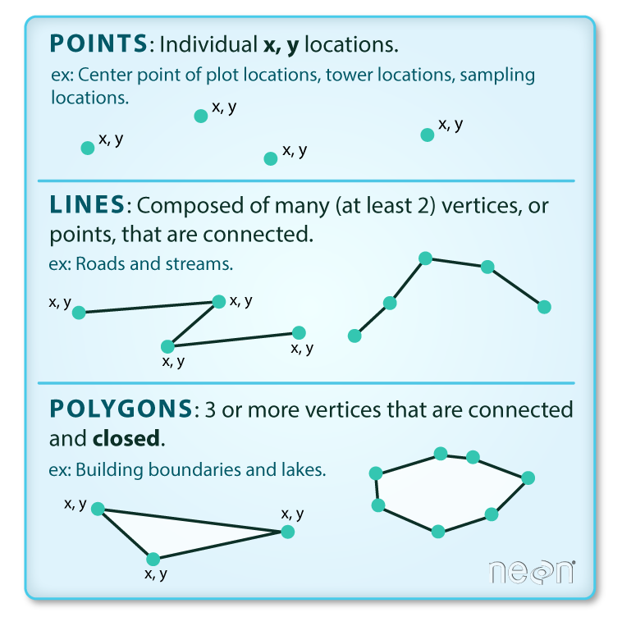
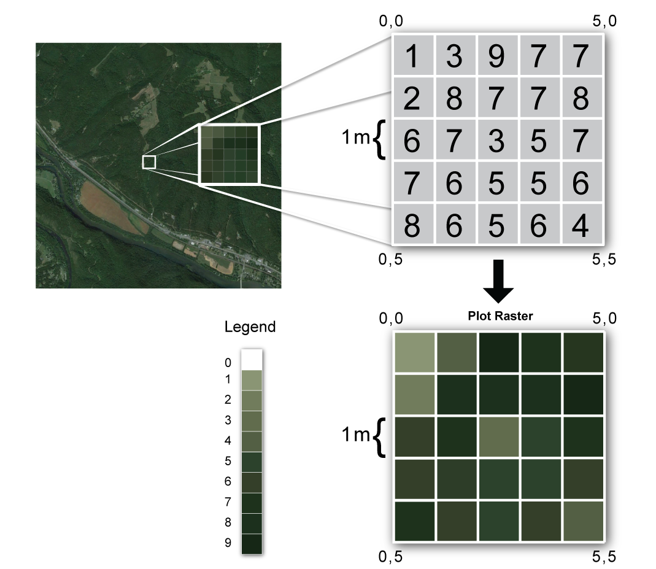
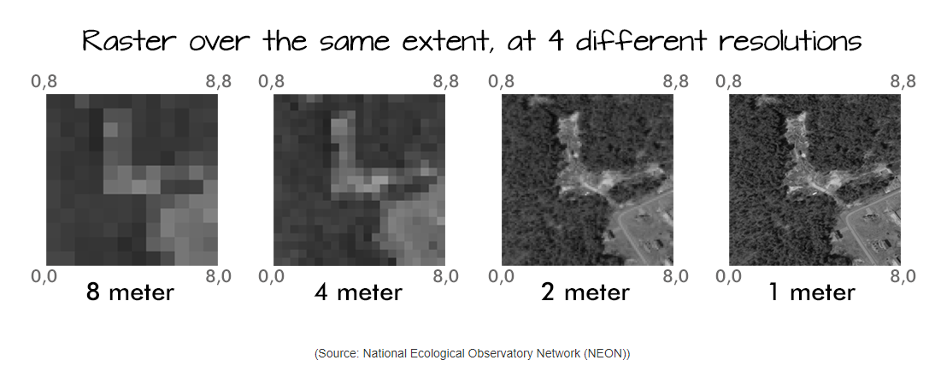
Vector and raster examples
Notes:
Source: http://docs.qgis.org/2.8/en/docs/gentle_gis_introduction/vector_data.html#overview

Slide 9

Gis
“Any system for capturing, storing, checking, and displaying data related to positions on the Earth’s surface”
National Geographic Education Encyclopedia
“In a GIS, you connect data with geography.”
- GISgeography.com
Geographic Information System (GIS)
A spatial system that creates, manages, analyzes and maps geographic data
Connects data to a map
Integrate location data with descriptive information
Helps users understand patterns, relationships and geographic context

Slide 10






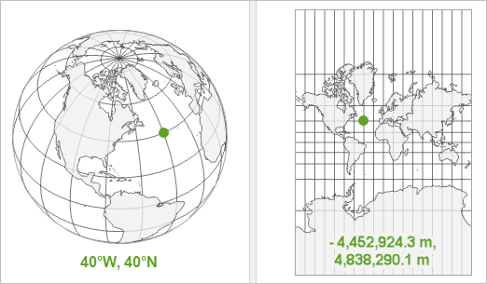
Coordinate systems
A reference framework defining the position of features in either 2- or 3-dimensional space
Maps use coordinate systems to locate and display data correctly on the earth’s surface relative to one another
Horizontal coordinate systems
Define where features are across the globe
Map always has horizontal coordinate system
Can be either geographic, projected, or local
Geographic coordinate systems (GCS) based on a 3D spherical surface & locations defined using angular measurements (usually decimal degrees) using degrees of longitude and latitude
Projected coordinate systems (PCS) are planar systems that use linear measurements for the coordinates rather than angular units
Composed of geographic coordinate system and a map projection
A map projection contains the mathematical calculations that convert the angular coordinates of the GCS to Cartesian coordinates of the planar PCS system
Local coordinate systems use a false origin (0, 0) in an arbitrary location anywhere on earth
Often used for large-scale (small area) mapping
False origin may or may not be aligned to a known real-world coordinate
Notes:
Vertical coordinate systems
Define how high or deep features are relative to a surface
Can optionally be added to map
There is more than one geographic coordinate system because each is meant to best fit certain portions of the earth
The best geographic coordinate system to use depends on where and how much of the earth's geography you are mapping

Slide 11

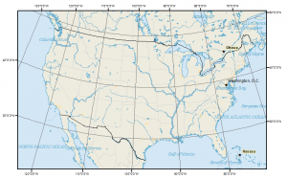
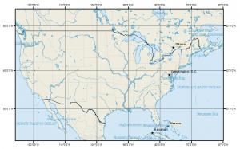
Map projection
Coordinate System
Map Projection
The means by which you display the coordinate system and your data on a flat surface, such as a digital screen
Mathematical calculations are used to convert the coordinate system used on the curved surface of earth to one for a flat surface.
There really is no one best map projection. Each map projection distorts shape, distance, direction, scale, or area and cannot preserve all map properties at the same time
A 3D globe is the only true surface where directions, distances, shapes, and areas are true
Extent, location, and property you want to preserve must inform your choice of map projection for your projected coordinate system
Primarily work in WGS 84 (latitude and longitude)
Referred to as EPSG:4326
In NYC, we use a more accurate projection NY State Plane/Long Island Zone
Referred to as EPSG:2263
Lambert Conformal Conic
Mercator

Slide 12
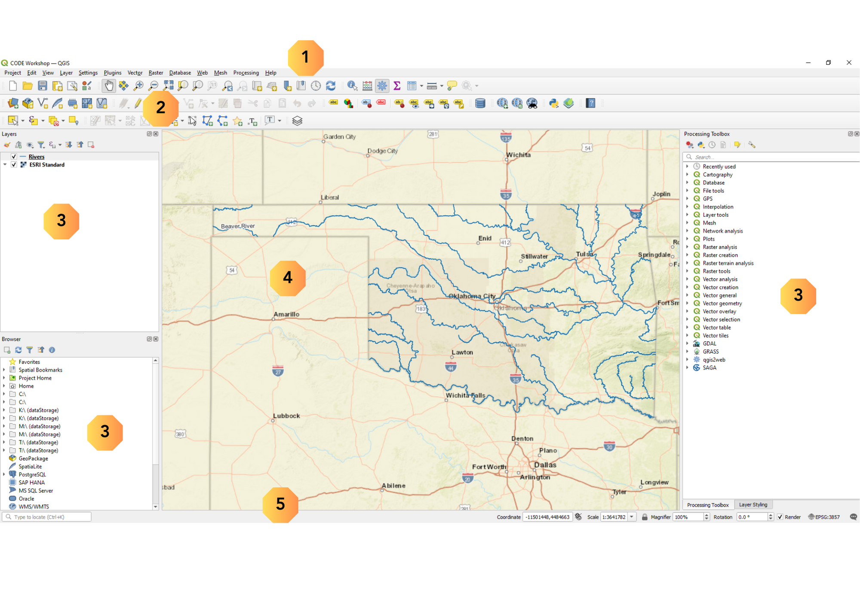

The QGIS Graphical User Interface (GUI)
Menu Bar
Tool Bars
Panels
Map View
Status Bar

Slide 13
Getting started
Download and unzip the NYC Boroughs dataset and then open QGIS

Slide 14
Layer attributes
Right click on the borough layer to open the attribute table

Slide 15
Styling features
Right-click the layer and select the Properties option
Select "Style," and choose “Categorized”
Select the column that has the data you want to style
Select “Classify”
Click “Apply” and “Ok”

Slide 16
Add labels to data
From Properties, select "Labels", "Show labels for this layer"
Select the column that has the data you want to use for labels
Click "Apply", “Ok”

Slide 17
Styling labels
Your turn
Style the polygons however you'd like
Change the outline color or add a pattern
Style the labels
Change the font, the font size, or other
attributes

Slide 18
Adding layers
Download and unzip the 311 DOT service requests data and open in QGIS
Layer Ordering
Layers on top are drawn on top
Just drag and drop within the Layers Panel to change order

Slide 19
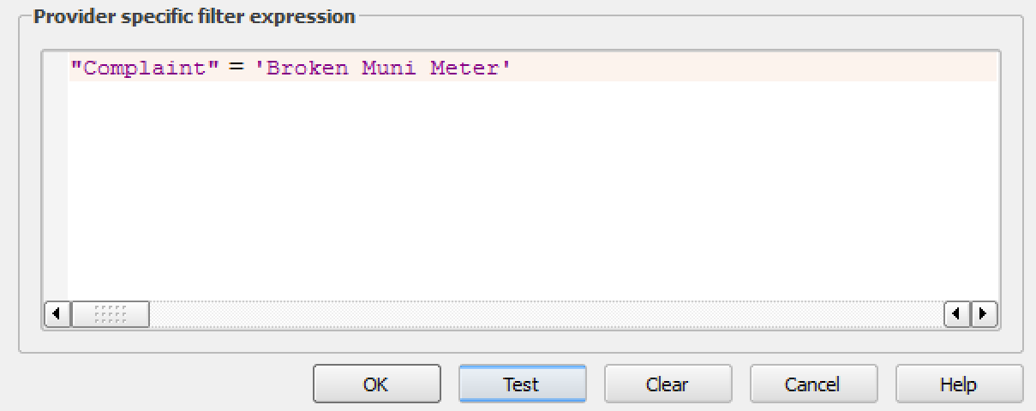
Filter and query
Filter
We can filter the points based on the values in the attribute table
Right-click on the layer and select "Filter" to open the Query Builder
To filter for broken Muni Meter complaints:
TIP: Always test your queries to make sure they return resulting rows

Slide 20
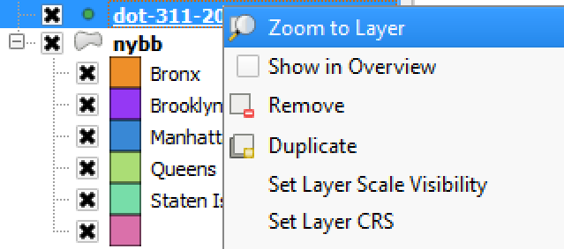
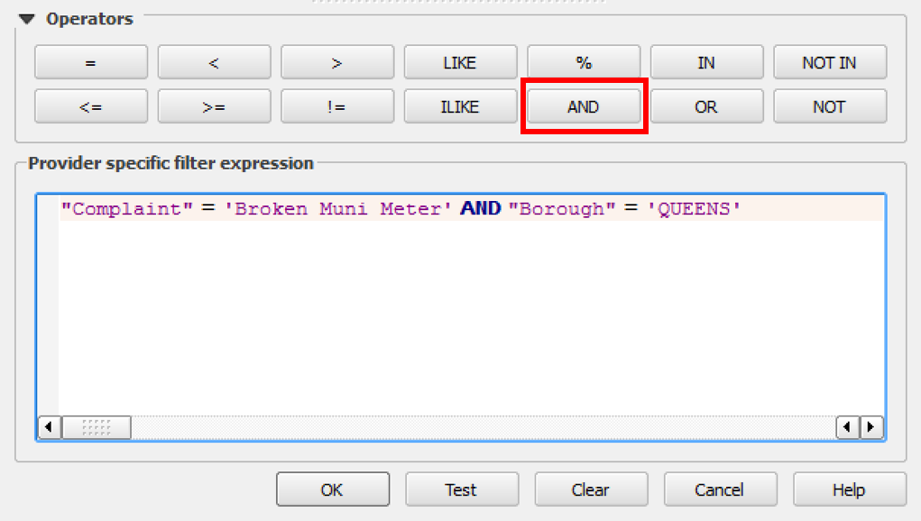
Filter and query
Zoom to layer
To filter by multiple conditions
Zoom Selection (select and draw box)
Pan Map (select and pan map)
Return to previous map extent

Slide 21
Exporting data
Your Turn
Filter for service requests in your borough
Try and find something interesting
Change the style of the point, either to a different shape, color, or icon
Export your selection as a new shapefile

Slide 22
Adding csv data
Adding Parking Facilities
Save the parking facilities csv file to your desktop

Slide 23
Adding csv data

Slide 24
Saving csv file as shapefile

Slide 25
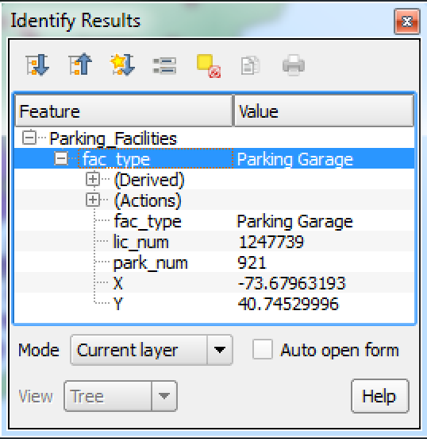

Inspect Features
Click Feature
Select Features

Slide 26
Show selected features in attribute table

Slide 27
Save selected features as a Shapefile
Reproject features into different CRS
If we wanted to reproject the data into a different CRS, we could do that here
Pick the new projection in the CRS field (like when we imported the CSV)

